Slide 1
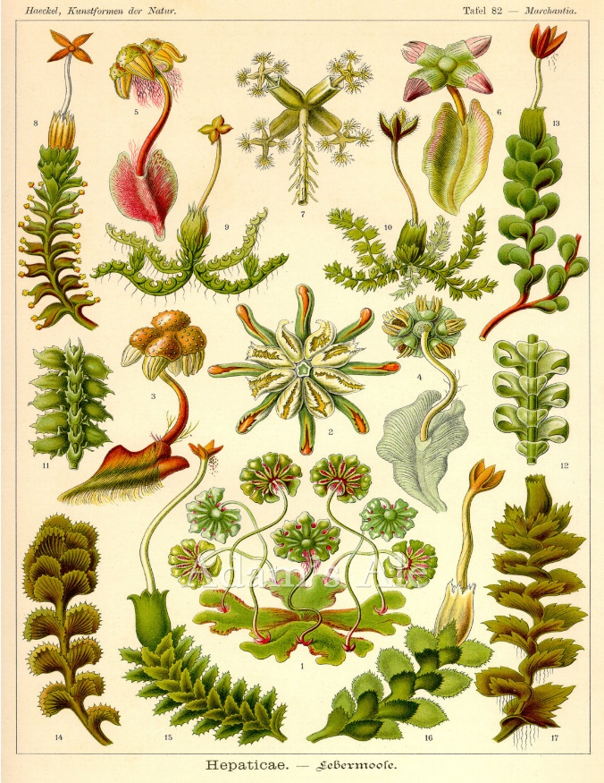
Peapod Tattler
Dedicated to my beautiful, wistful wildly creative daughters who inspired this creation. Love what you do and you will never fail.
Volume I
Est. February 5, 2008
Monday, February 2, 2015
The Ozarks’ First Nature Preschool
.
Notes from the Nest
Hello Parents,
We are working on the auto pay system but when we signed up they did not realize how many of you there are- and there is a processing time to each of these merchant accounts. We are actually going to start the auto pay in March instead of the first of February due to the processing time. I am very sorry for any inconvenience this causes (I too am looking forward to having an automated system). Please continue to leave payment for the month of February in the pink mailboxes (one week at a time or otherwise whatever meets your needs). Thanks for navigating this new technology with us!
~Miss Carly
Meal Times
Parents,
Beginning February 9 the multi-purpose room will be reserved for breakfast and lunch for the Sprouts and Saplings. Due to USDA food safety regulations there are some changes to how we will be serving our meals. Food and beverage temperatures must be maintained and there is a limit on how long food can sit out. Breakfast will be served family style at 8:00 am and children will return to their classrooms at 830 to begin their school day. Lunch is served at 11 then students are dismissed at 1130 to return to their rooms. Breakfast will not be served past 830am as food served family style must be discarded after 30 minutes.

Slide 2
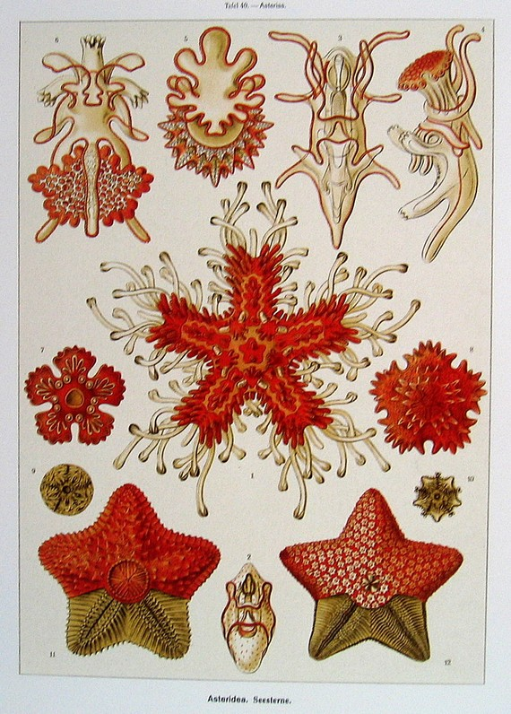
Upcoming Events:
Wednesdays 10am, Organ Wise Guys
Thursdays, 10am, Tunes for Tots
Fridays at 10am: Stretch and Grow
Monday, February 2, Groundhog’s Day
Valentine’s Day Party, Friday Feb 13, 3:00pm
Thursday, February 12, Zoo Class 3:00pm
Monday, February 16, Presidents’ Day, Peapod Closed
Tuesday, February 17, Stories to Go, 10am
.
VERY IMPORTANT
We are a NUT FREE center as of this week. No snacks or nut products will be served or allowed in meals from home. We have students attending that are highly allergic. Thank you for helping us keep all of our children safe!
Valentine’s Day Party Fri, Feb. 13th at 3pm
Where: 2214 E Seminole. This is a combo party for the house location and Preschool- a great time to let the kids see their friends and socialize with other families. There will be games, crafts, and prizes! Please create a box with your child and bring it by Thursday the 12th. Valentine’s Day lists will be coming home next week for each class.

Slide 3
Carly’s Kitchen *Menu items subject to change due to unforeseen kitchen emergencies. ☺
Feb 2-6, 2015
 | Monday | Tuesday | Wednesday | Thursday | Friday
Breakfast | Milk, apples, croissants | Milk, oranges, wheat toast, butter | Milk, bagels and cream cheese, bananas | Milk, fresh pineapple, buttermilk biscuits | Milk, pears, sweet potato waffles, syrup
Lunch | Home-made meatloaf, mashed potatoes, corn, dinner rolls, milk | Roasted chicken vegetable soup with bowtie noodles, whole wheat garlic bread, apple slices, milk | Roasted pork loin with mashed potatoes and home made gravy, steamed broccoli, wheat toast, milk | Home made 7 Layer Dip with chips, salsa, salad, quesadilla wedge, milk | Spaghetti marinara with garlic cheese bread, sautéed green beans, and milk
Snack | Nectarines, toll house crackers | Whole wheat goldfish crackers, plums | Animal crackers, apples | Veggie crackers, baby carrots and ranch | Haystacks with ranch (veggie sticks: Celery, Carrots, zucchini, squash), cheddar cheese

Slide 4
Seeds (birth-3 years) February 2-6
Domain | Monday | Tuesday | Wednesday | Thursday | Friday
Self and Social (SSD) | Puppet Story | Practice friends names | Practice teacher names | How many friends are here today? | Recognition of personal blankets
Language and Literacy | “Love” letter recognition | Love themed book | Practice saying “I love you!” | “Love” sign language | “Child’s Play series”
Cognitive | Building with blocks | Nature recognition | I-Spy in a book | Sorting crayons | Singing familiar songs
Physical Development | Dancing! | Baby Yoga | Fishing for cheerios | Nature walk | Pouring water
Health | Cleaning the tables | Learn about the toilet and potty training | Practice running safely | Talk about dirt! Washing dirty hands | Strawberry heart snacks
Sensory | Heart canvas painting | Feet heart project for bulletin boards | “Love Bug” art | Heart shaped sun catcher | Rainbow spaghetti sensory play

Slide 5
Sprouts (ages 2-3 years) February 2-6, 2015
Domain | Monday | Tuesday | Wednesday | Thursday | Friday
Self and Social | Felt Faces | Feeling Plates | “Good Morning Chart” | “Happy Bubbles” | Hands are not for Hitting
Language and Literacy | Alphabet Mystery Book | “Bring the Book to Life | Make Letters with our play dough | Invitations | Alphabet Mystery Book
Cognitive | Tape Road | Tube Play | Mystery Bag | String Scavenger Hunt
Motor and Perceptual | Pipe Cleaner Strainer | Rainbow Counting | Snowflake Puzzle | Graphing Berries | “All the Supplies”
Health | Healthy Food Hunt | Vegetable painting | Paper Pizza | Eating a Rainbow | Toothbrush Paints
Science, Sensory, Art | Snowflake Painting | Float or Sink | G is for Gravity | Sensory Bags | Piles of Ribbon

Slide 6
Saplings Preschool Feb 2-6
 | Monday | Tuesday | Wednesday | Thursday | Friday
Morning Meeting | Locate Pennsylvania on map, Song I see a little Groundhog, Mr. Groundhog | Shadows (see interest in space) | Space! Sun-Planets | Rocket Ships, astronauts | Stars
Writing Center | Groundhog day pictures with words; Burrow, Feb. 2, Phil | Shadow letters, drawing shadows | Names of the planets; space journal | Mailing letters | Names of constellations
Math Center | Animal counters, groundhog cut-out (ordering numbers) | Sundials | Cutting circles, spheres, Sun catchers | Countdown cards | Counting stars
Science Center | Where do Groundhogs live? Habitat | Pictures of planets, making shadows with flashlights | Space pictures | Astronaut food; Dehydrated fruit | Constellations, galaxy play dough making
Dramatic Play | Animal songs and animal actions; shadow tag/shadow shapes | Flashlights, shadow stories | Rotating around the sun | Astronauts: Teamwork | Cooking with galaxy playdough
Art Center | Groundhog pop up craft | Shadow painting Shadow tracing (bodies) | Painting coloring planets | Sun Drawings, Rocket Ship: Name with paper towel roll | Glow in the dark
Books/Literacy | Groundhog shared writing | Making “SH” words, Sunshine makes the Seasons | Space Exploration | Big Dipper, What do astronauts do? | Harriet Tubman

